Slide 1

Gender recognition by voice
-ML2
Shripad hendre
https://github.com/ShripadH
https://www.linkedin.com/in/shripadh/

Slide 2
Introduction
This database was created to identify a voice as male voice or female voice,
This is based upon acoustic properties of the voice and speech.
The dataset consists of 3,168 recorded voice samples, collected from male and female speakers.
Data has 20 explanatory variables and one target variable (i.e. label)
The voice samples are pre-processed by acoustic analysis in R using the seewave and tuneR packages, with an analyzed frequency range of 0hz-280hz (human vocal range).

Slide 3
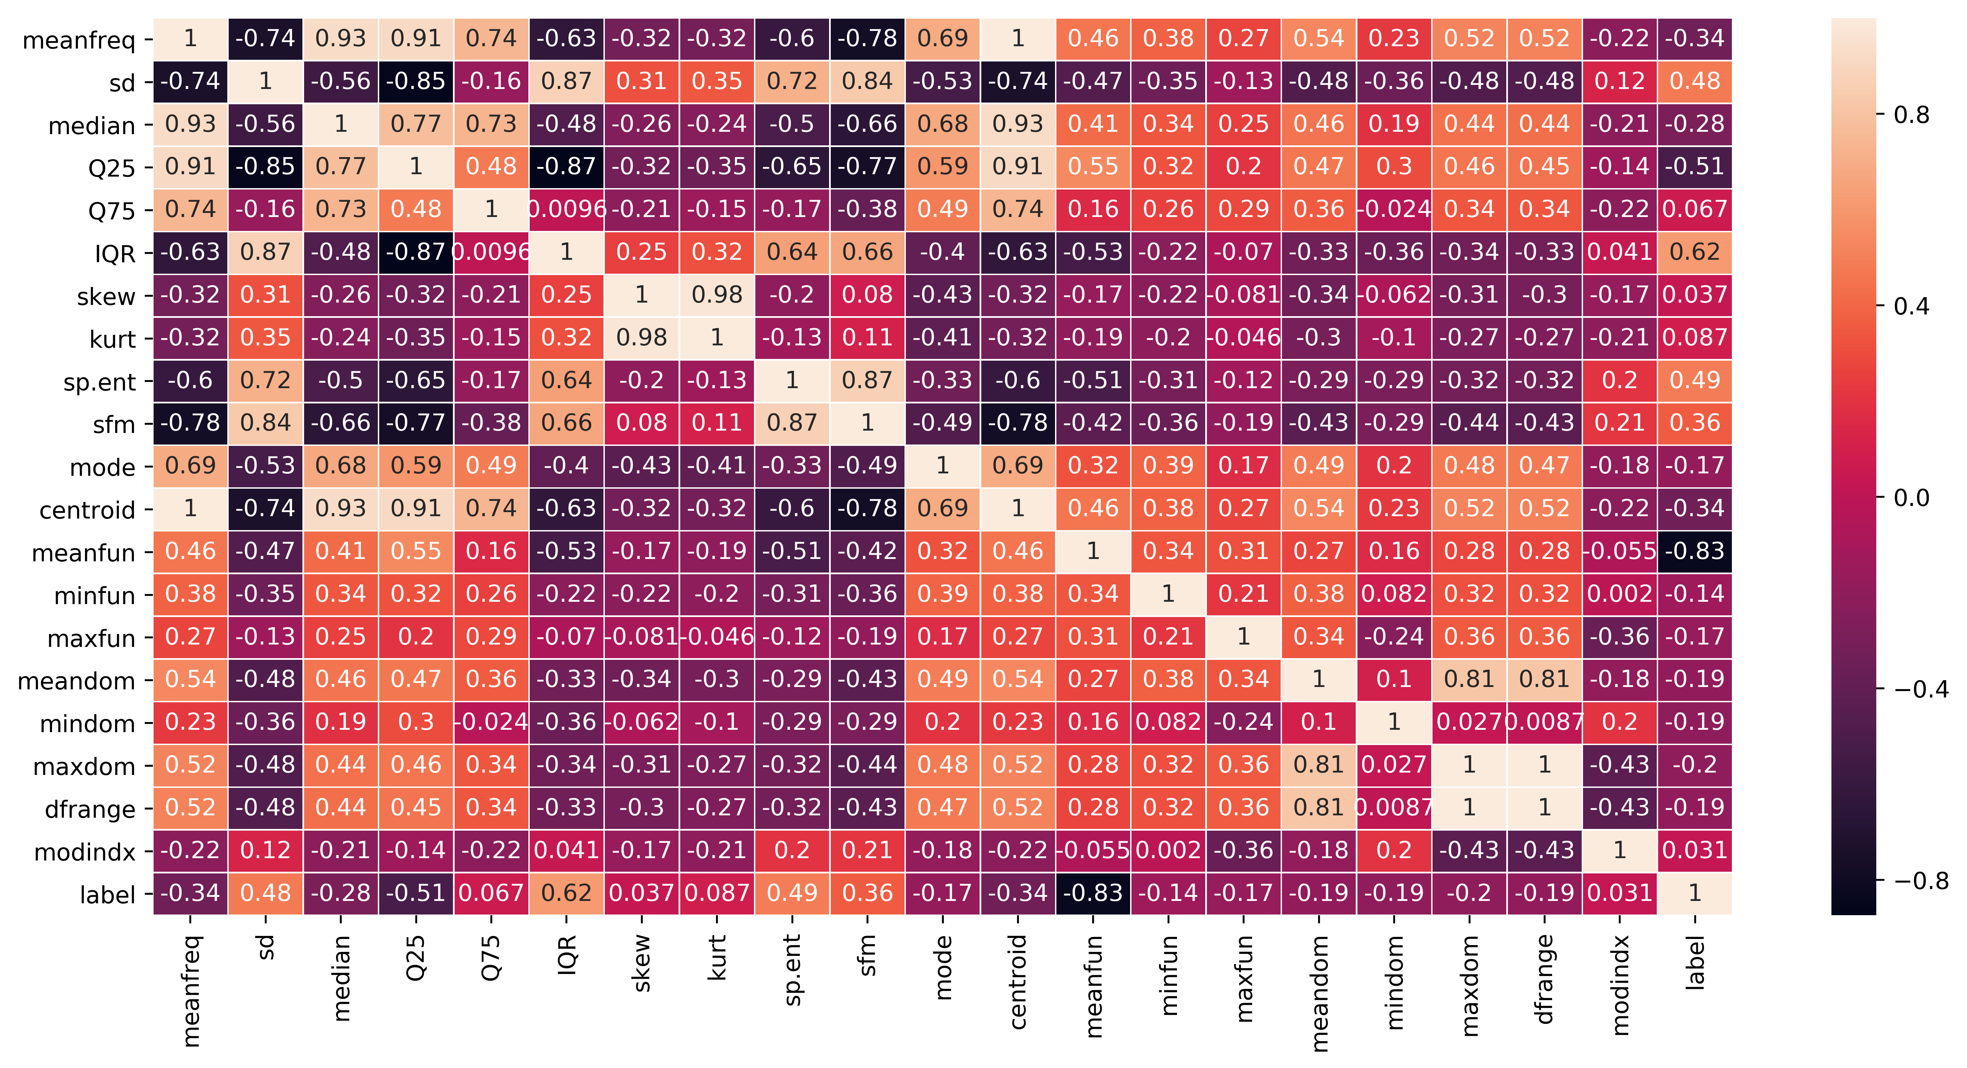
Data Correlation Matrix

Slide 4
Mean frequency is moderately related to label.
IQR and label tend to have a strong positive correlation.
Spectral entropy is also quite highly corelated with the label while sfm is moderately related with label.
Skewness and kurtosis aren't much related with label.
Meanfun is highly negatively corelated with the label.
Centroid and median have a high positive correlations expected from their formulae.
Also note that MeanFrq and Centroid are exactly same features as per formule and values. Hence their correlation is 1. In that case we can drop any of the column. But we will keep all columns.
kurt and skew are also highly corelated.
Centrold is highly related to Medainas well as Q25.
IQR is highly corelated to sd.
Finally self relation i.e. of a feature to itself is equal to 1 as expected.

Slide 5
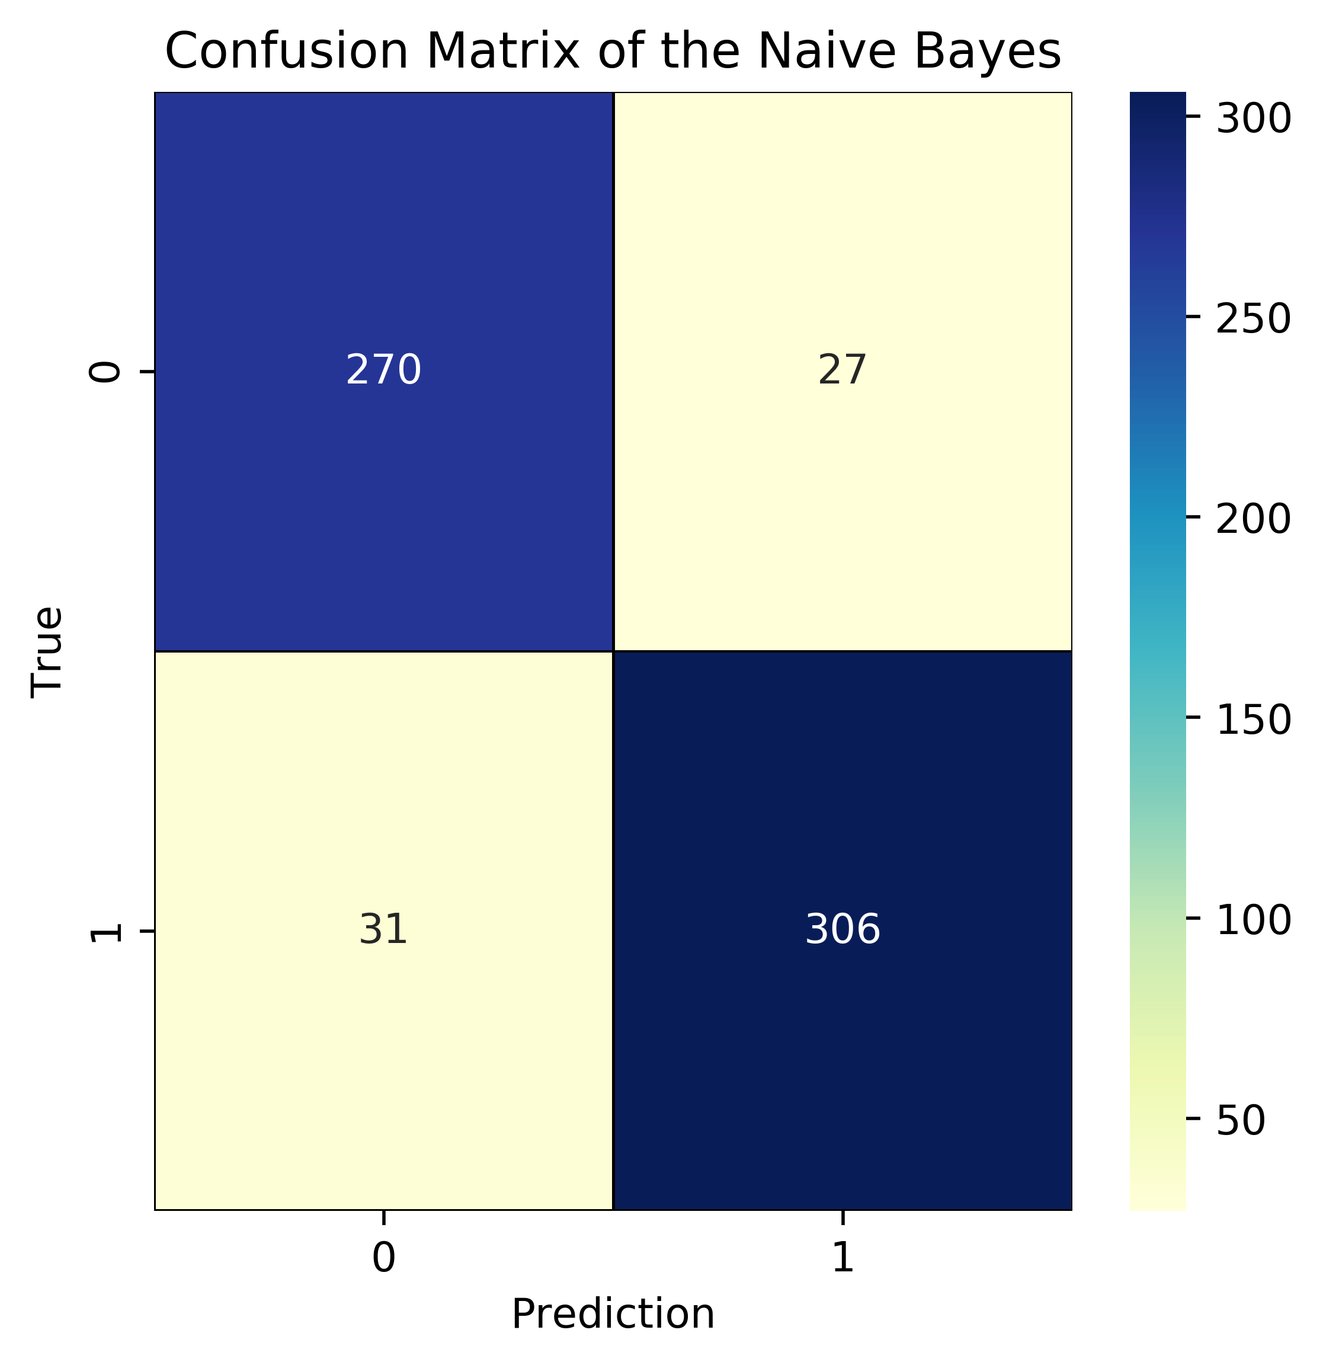
Naive Bayes (90.852%)

Slide 6
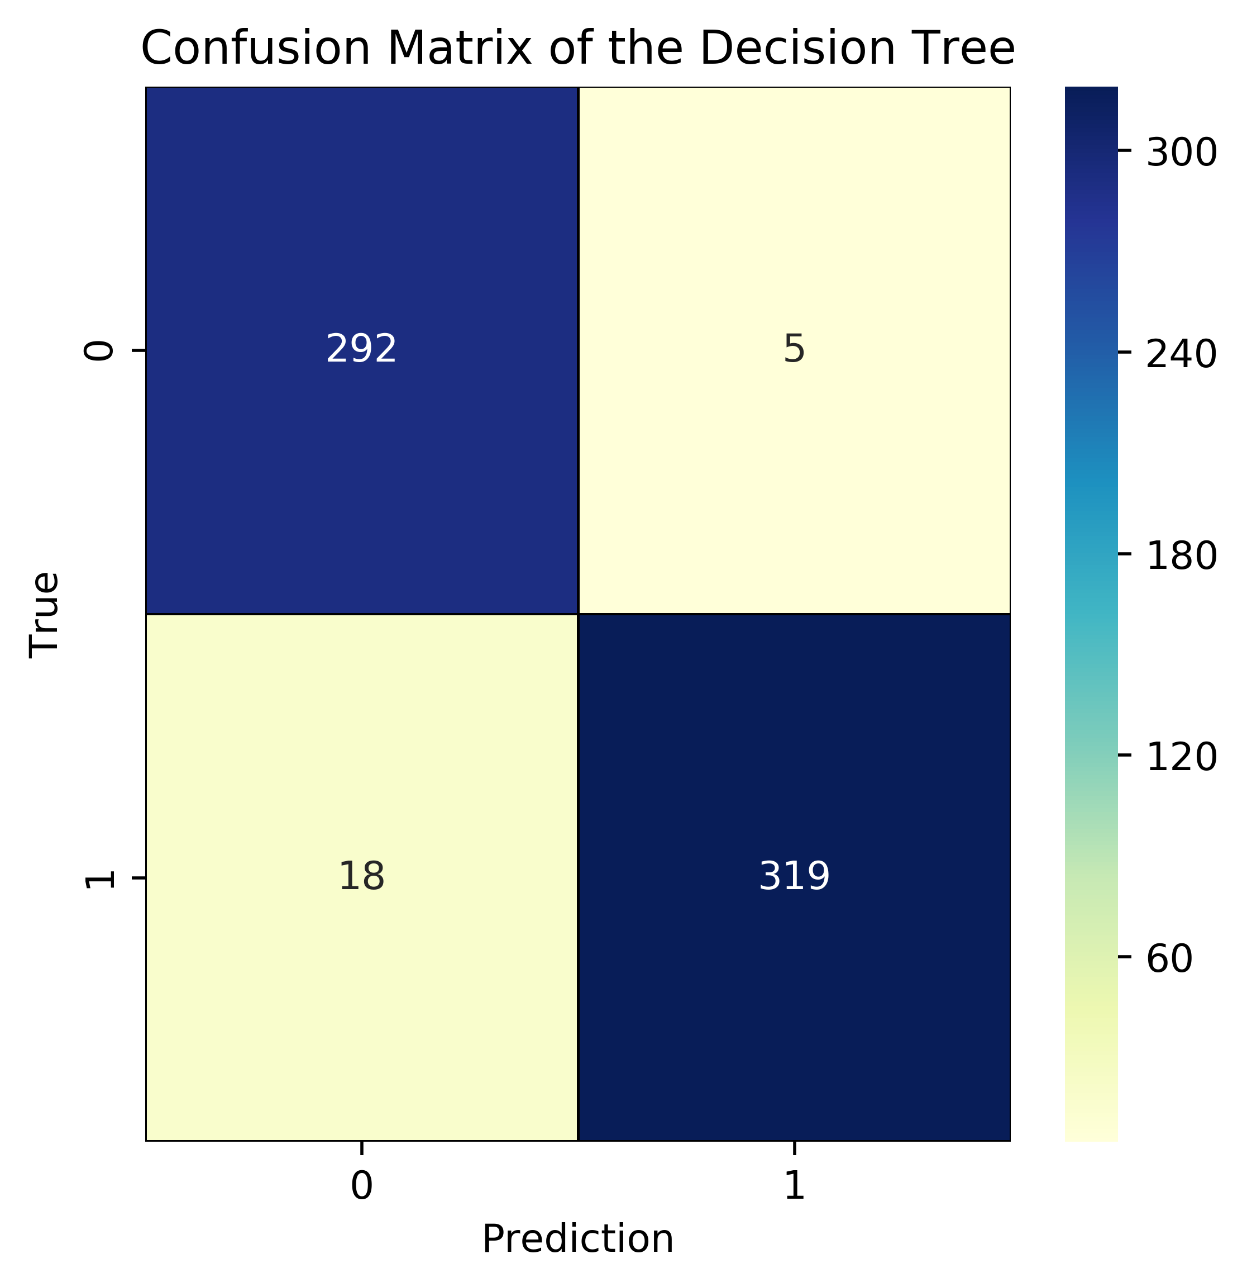
Decision Tree (96.688%)

Slide 7
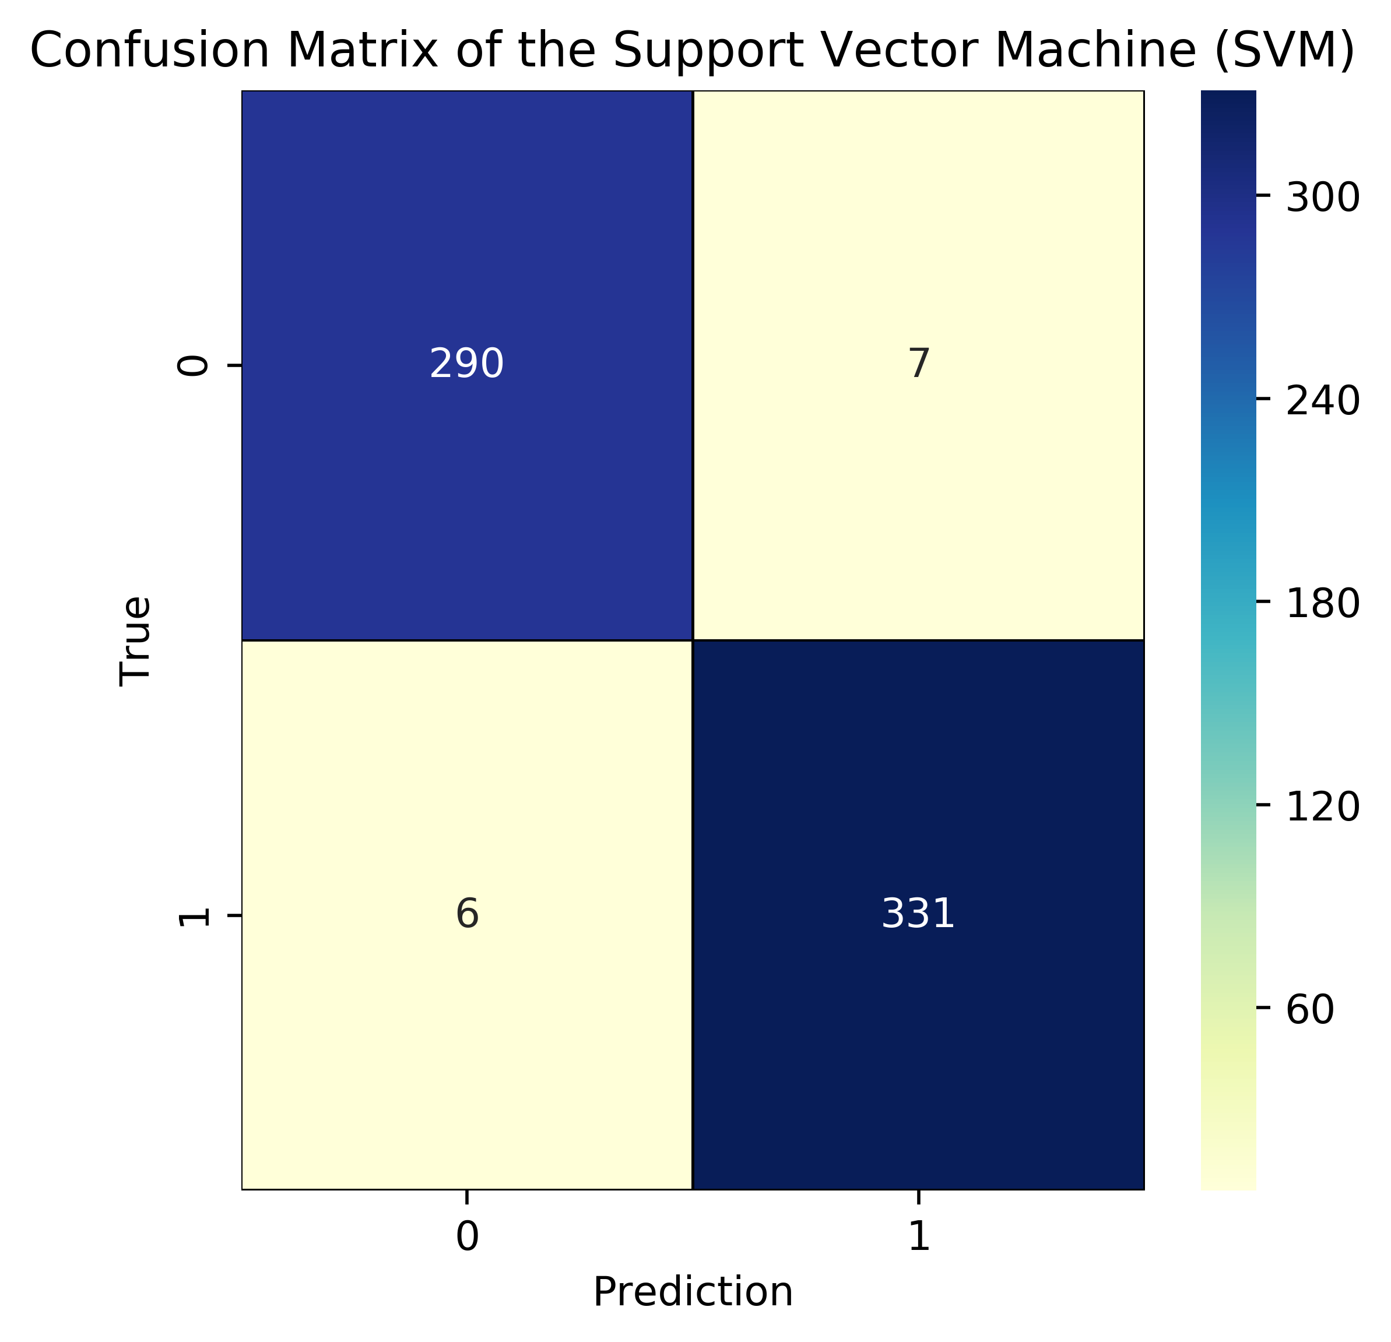
Support Vector Machine (97.95%)

Slide 8
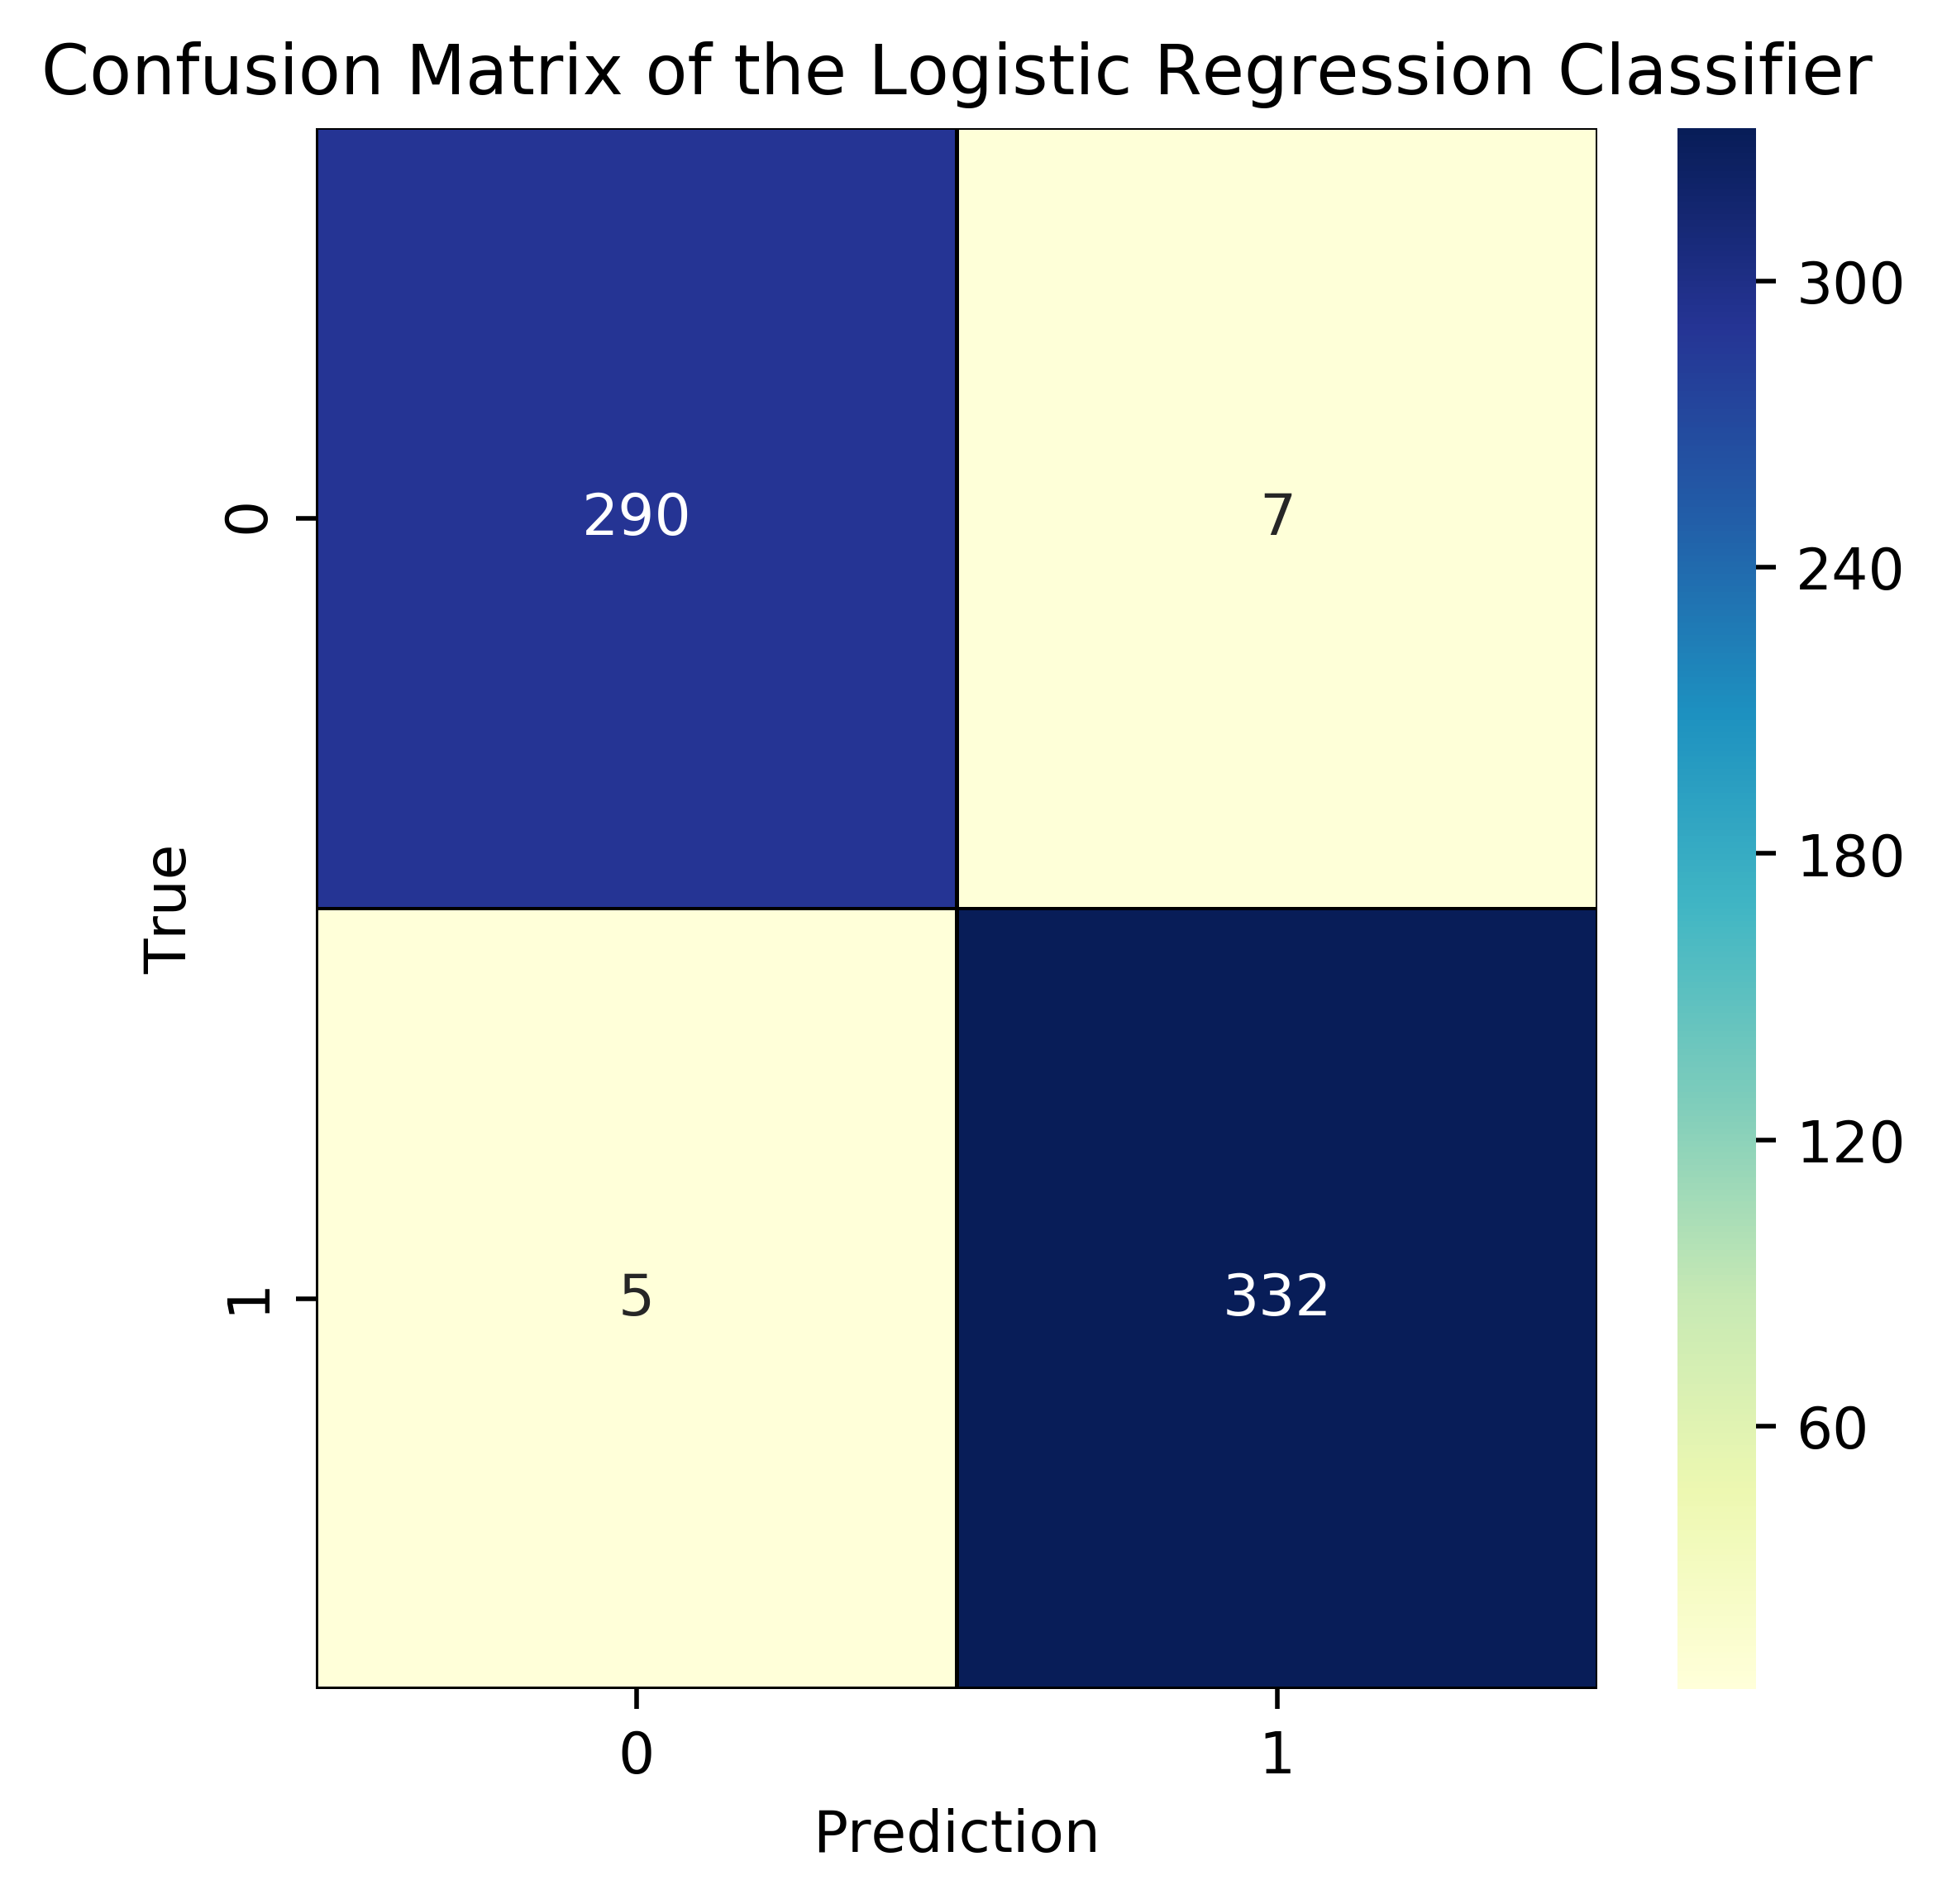
Logistic regression – (98.107%)

Slide 9
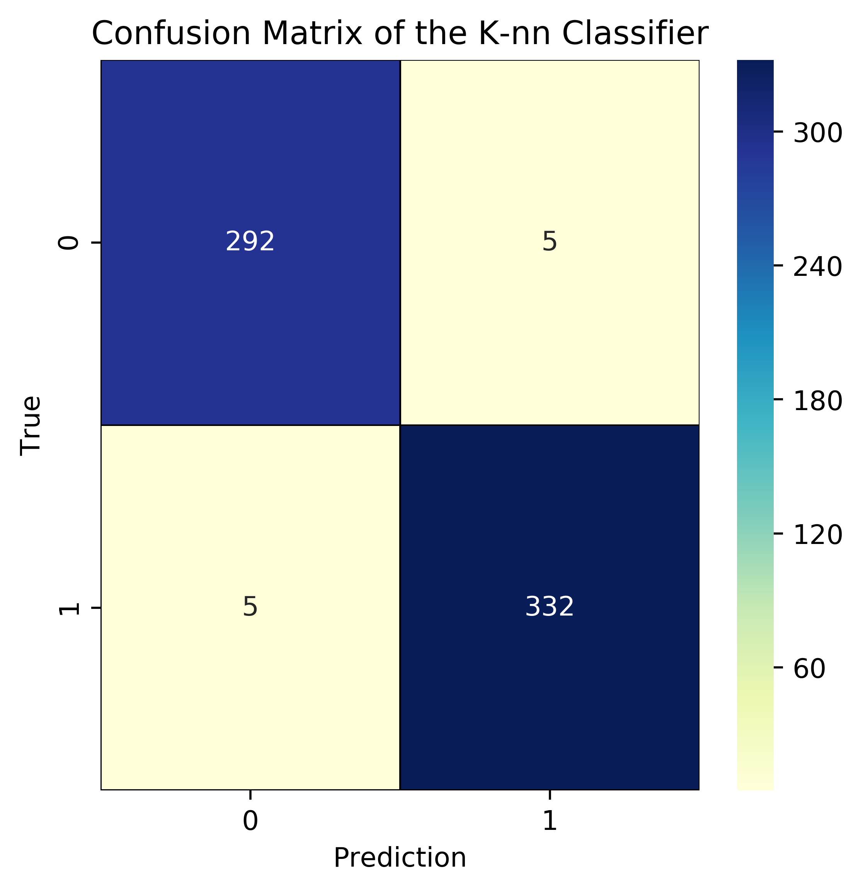
KNN- Classifier (98.432)

Slide 10
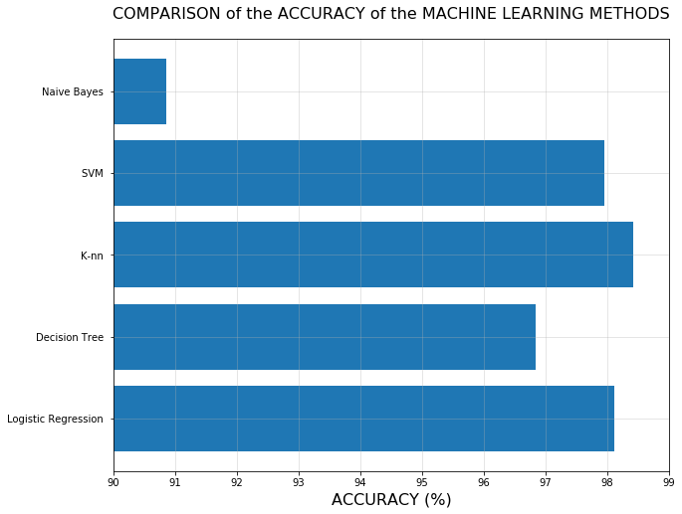
Accuracy comparison

Slide 11
Insights
Comparison in all models-
Naïve Bayes – 90.852%
Decision Tree – 96.688%
SVM (Random State =1) – 97.95%
Logistic regression – 98.107%
KNN Classifier (K=8) – 98.432%

Slide 12
Thank You

